Slide 1
London lit map
An Interactive Visualization of Horror, Criminality, and Poverty in 19th-Century London

Slide 2
Our Project
A map of 19th-Century London that explores the intersection between contemporary perceptions of Fantasy Horror, Crime, and Poverty:
Use the Charles Booth Poverty Map as Our Map
Plot Significant References in 19th-Century Horror Fiction onto the Map with its Text
Plot Influential and Infamous Contemporary Crimes as well (e.g. the Whitechapel Murders)

Slide 3
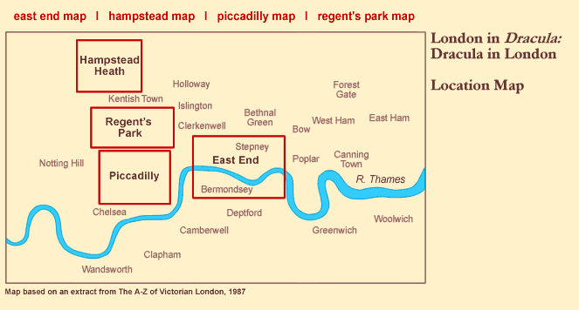
Inspirations and Influences
Dracula in London: London in Dracula

Slide 4
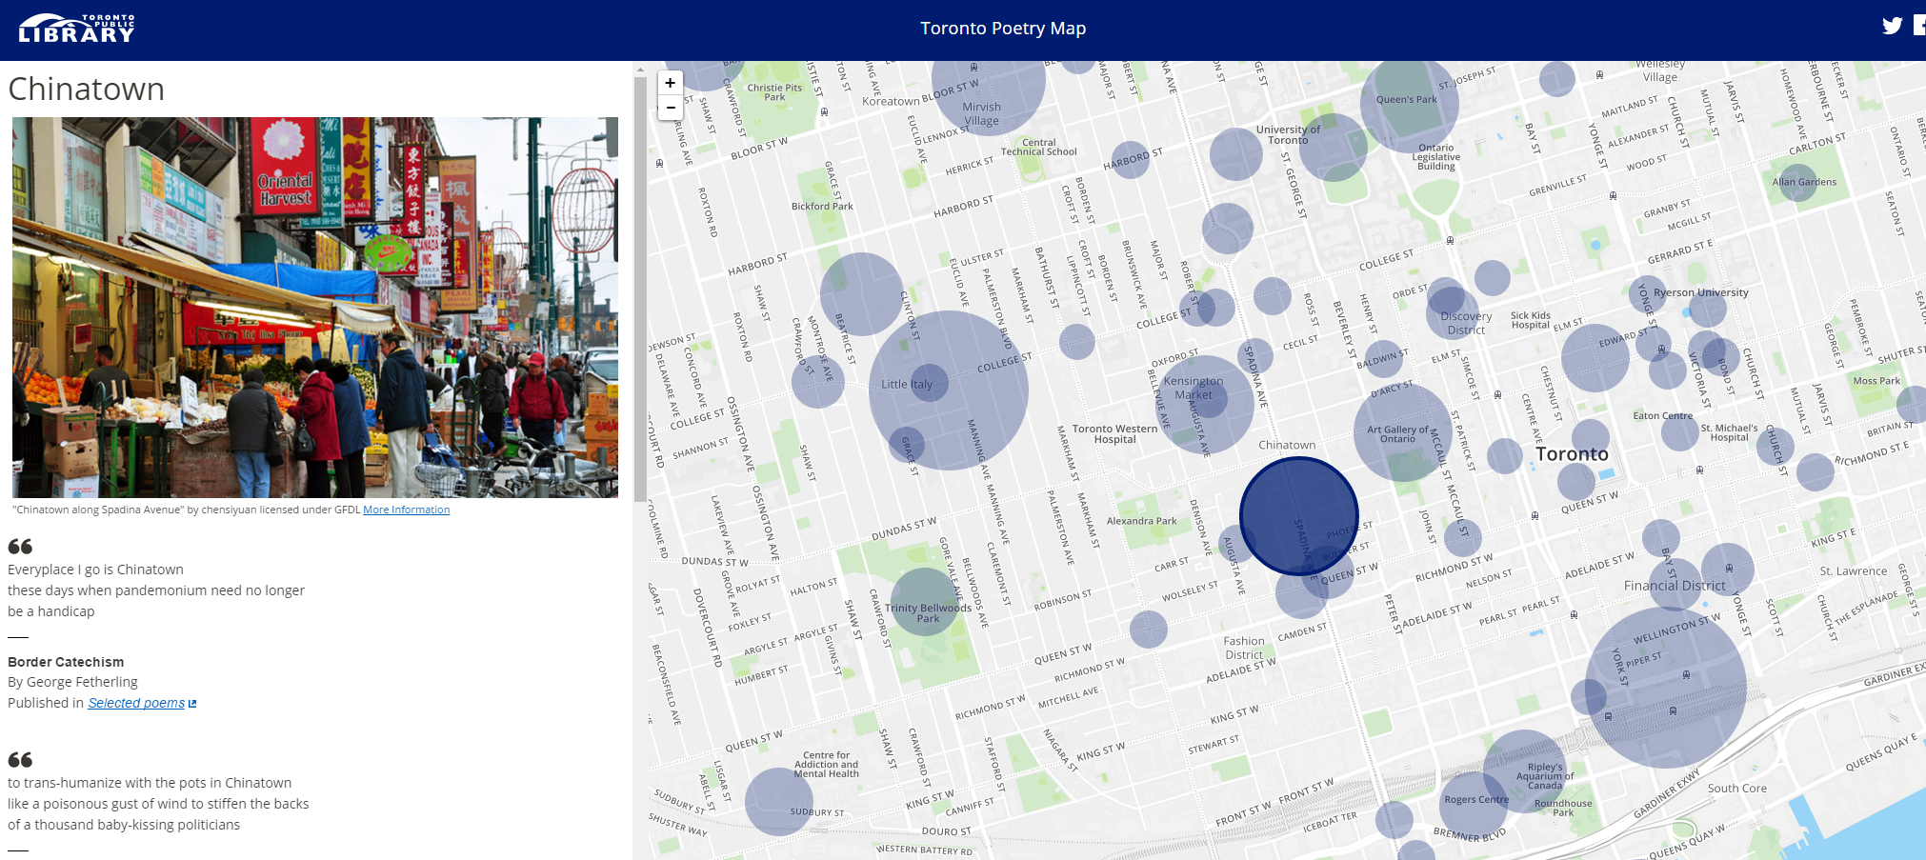
Inspirations and Influences
Toronto Poetry Map

Slide 5
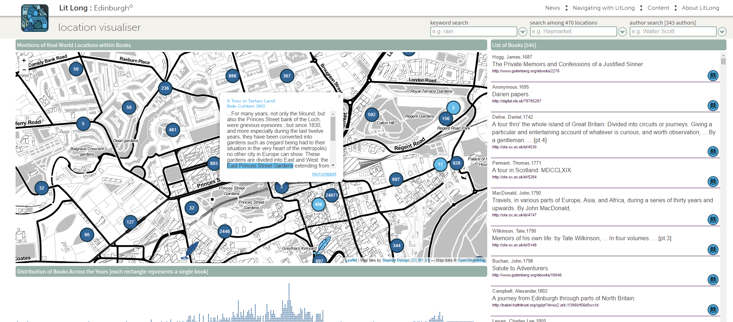
Inspirations and Influences
Lit Long Edinburgh

Slide 6
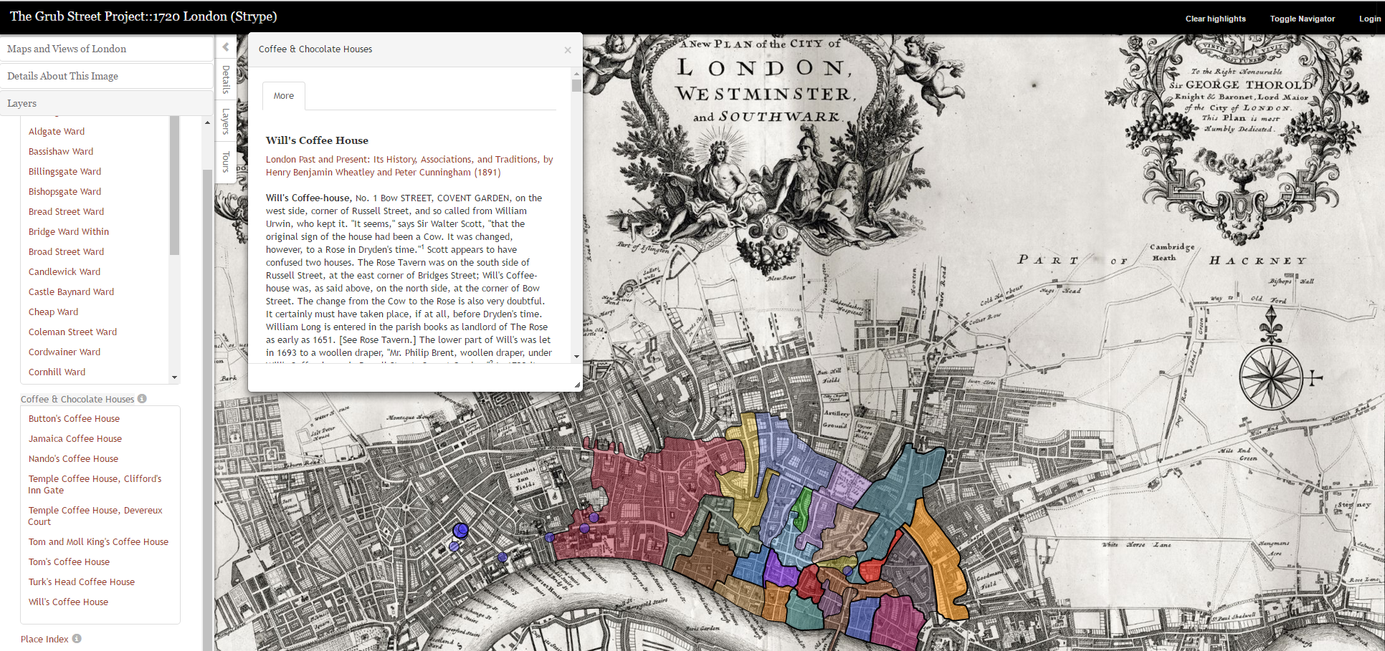
Inspirations and Influences
Usask Grub Street Project (1720 London)

Slide 7
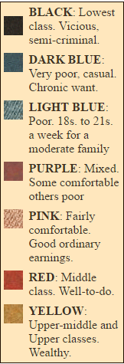
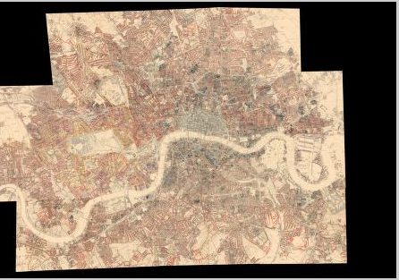
Inspirations and Influences
Charles Booth Poverty Map (19th-Century)

Slide 8
Functionality
Zoomable, Pannable Map
Transparency Overlay with 19th-Century Booth Map and Map of Modern London
Interactive Point, Route, and Area Markers with Accompanying Text
Filter by Work, Event

Slide 9
Demo Now!

Slide 10
Interpretations
General:
A useful perspective for conveying distance
Helps us understand the London of the reader/author in a way that just reading cannot
Brings attention to shared space(s)
Specific:
Stories often take place in a particular region
Dracula engages with the space of the Whitechapel Murders

Slide 11
Challenges
Preparing Booth’s map.
Sourcing and combining images (still not satisfied)
The Maptiler solution?
Need to scrape analog (still the best way)

Slide 12
Reflection/Future Pursuits
Get in touch with the Booth Archive (PhoneBooth app)
Integrate something more elegant than window boxes (modal or, ideally, sidebar)
Aesthetic changes
More maps (filters)
Add more content!
Integrate other projects (East Coast Horrors).
Explore similar projects: Saskatoon Experience Map (working title), Drugs and Travel Literature

